Slide 1
高级人工智能
第一章 绪论
史晓东
厦门大学
http://121.192.180.171:8080/

Slide 2
Outline
What is AI?
A brief history
The state of the art
课程介绍

Slide 3
教材
S. Russell and P. Norvig Artificial Intelligence: A Modern Approach Prentice Hall, 2010, Third Edition, 早期版本也没问题,我们会补充些新的内容

Slide 4
What is AI?
Views of AI fall into four categories:
Thinking humanly "The exciting new effort to make computers think ... machines with minds, in the full and literal sense." (Haugeland, 1985) “[The automation of] activities that we associate with human thinking, activities such as decision-making, problem solving, learning .. .” (Hellman, 1978) 文 | Thinking rationally "The study of mental faculties through the use of computational models." (Charniak and McDermott, 1985) “The study of the computations that make it possible to perceive, reason, and act.” (Winston, 1992) 理
Acting humanly "The art of creating machines that perform functions that require intelligence when performed by people." (Kurzweil, 1990) "The study of how to make computers do things at which, at the moment, people are better.“ (Rich and Knight, 1991) 工 | Acting rationally "Computational Intelligence is the study of the design of intelligent agents." (Poole et al, 1998) “Al ... is concerned with intelligent behavior in artifacts.” (Nilsson, 1998) 用

Slide 5
Thinking humanly: cognitive modeling
1960s "cognitive revolution": information-processing psychology
Requires scientific theories of internal activities of the brain
  1) Predicting and testing behavior of human subjects (top-down)
  or 2) Direct identification from neurological data (bottom-up)
Both approaches (roughly, Cognitive Science and Cognitive Neuroscience) are now distinct from AI
相关研究：情感计算、评价挖掘、舆情分析…
-- How to validate? Requires

Slide 6
Thinking rationally: "laws of thought"
Aristotle: what are correct arguments/thought processes?
Several Greek schools developed various forms of logic: notation and rules of derivation for thoughts; may or may not have proceeded to the idea of mechanization
现代AI中的逻辑除了包含一阶逻辑之类的古典逻辑以外，还有非单调逻辑、自然语言逻辑、模糊逻辑、弗协调逻辑、各种推理（常识推理、归纳推理、时间推理、因果推理、不确定推理等）方法等。
Problems:
  Not all intelligent behavior is mediated by logical deliberation
中国人不重视大逻辑（但是喜欢小聪明）

Slide 7
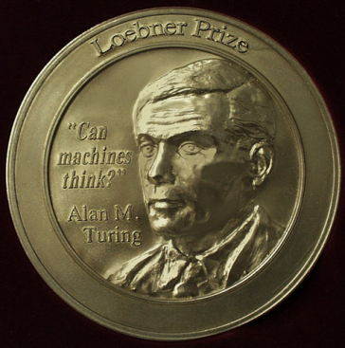

Acting humanly: Turing Test
Turing (1950) "Computing machinery and intelligence":
"Can machines think?" → "Can machines behave intelligently?"
Operational test for intelligent behavior
Predicted that by 2000, a machine might have a 30% chance of fooling a lay person for 5 minutes
Anticipated all major arguments against AI in following 50 years
Suggested major components of AI: knowledge, reasoning, language understanding, learning
也称作：狭义AI

Slide 8
Acting rationally: rational agent
Rational behavior: doing the right thing
The right thing: that which is expected to maximize goal achievement, given the available information
Doesn't necessarily involve thinking – e.g., blinking reflex – but thinking should be in the service of rational action

Slide 9
Rational agents
An agent is an entity that perceives and acts
[f: P* → A]
For any given class of environments and tasks, we seek the agent (or class of agents) with the best performance
  → design best program for given machine resources
Caveat: computational limitations make perfect rationality unachievable
This course is about designing rational agents
Abstractly, an agent is a function from percept histories to actions:

Slide 10
AI到底是什么？
AI就是建造 rational agents？
  书本观点强调agent
  理性，可能掩盖/发扬人性的善/恶
    理性会导致“囚徒困境”，从而得到并非是最佳的结果
    AI and ethics: project Maven
  你们完全可以有自己的想法

Slide 11
弱AI和强AI
Weak AI, or Narrow AI:focuses on one narrow task which usually requires human intelligence.
Strong AI, or Artificial General Intelligence (AGI): aims for a universal algorithm for learning and acting in any environment, which is still largely a “dream”. AGI means a machine with sentience, consciousness and mind

Slide 12
Outline
What is AI?
A brief history
The state of the art

Slide 13
AI prehistory - Foundations of AI
Philosophy Logic, methods of reasoning, mind as physical
system foundations of learning, language,
rationality
Mathematics Formal representation and proof algorithms,
computation, (un)decidability, (in)tractability,
probability
Economics utility, decision theory
Neuroscience physical substrate for mental activity
Psychology thinking and actions of humans and animals,
experimental techniques
Computer algorithms, programming, fast computers
engineering
Control theory design systems that maximize an objective
function over time
Linguistics knowledge representation, grammar

Slide 14
人工智能历史(1)
  萌芽期（1943-1955）
  诞生（1956）
  early entusiasm, great expections (1952-1969)
  A dose of reality (1966-1973)
  知识就是力量（1969-1979)
  AI成为工业(1980至今）

Slide 15
人工智能历史(2)
  神经网络复兴（1986至今）
  AI成为科学（1987至今）
  智能体的出现（1995至今）
  大数据的兴起（2001至今）
  深度学习的兴起（2006至今）

Slide 16
萌芽期（1943-1955）
McCulloch & Pitts proposed a model of artificial neurons (1943)
  Any computable function could be computed by some network of connected neurons
Turing articulated a completed vision of AI in “Computing Machinery and Intelligence” (1950)
  Turing test, machine learning, genetic algorithm, and reinforcement learning

Slide 17
AI的诞生（1956）
世界上第一次正式的AI会议在美国的Dartmouth College召开，为期2月
会上John McCarthy 正式提出“Artificial Intelligence”这一术语
著名参加者：J.McCarthy、C.Shannon、M.Minsky、N.Wiener、W.McCulloch、S.Papert
2006年有一次50周年纪念会议，并展望下个50年
  http://www.dartmouth.edu/~ai50/homepage.html

Slide 18
early entusiasm, great expections (1952-1969)
1952-55：Samuel‘s checkers program disproved the idea that computers can only do what they are told to do (via reinforcement learning)
1956：Newell & Simon: Logic Theorist
1958: Newell和Simon: GPS.
1958：McCarthy 发明著名的人工智能语言Lisp
1959: Frank Rosenblatt提出感知器模型
1959: Minsky和McCarthy正式成立MIT AI Lab。
1962: McCarthy和Minsky分裂，McCarthy到Stanford, 1963年创建Stanford AI Lab

Slide 19
early entusiasm, great expections (1952-1969)
1963: M. Ross Quillian开创语义网络（Semantic Nets)
1965: MIT的Joseph Weizenbaum研制出ELIZA
  用英语进行交互
  回答任何问题
1969: SRI研制出机器人Shakey
  具有运动、感知和问题求解能力
1970: Stanford的Terry Winograd等研制出SHRDLU
  接受自然语言命令
  操作积木块
1970: Colmerauer研制出PROLOG语言的解释系统。不久，爱丁堡大学的Warren实现了编译系统

Slide 20
A dose of reality (1966-1973)
1958: Newell和Simon: 四个预测
  十年内，计算机将成为世界象棋冠军
  十年内，计算机将发现或证明有意义的数学定理
  十年内，计算机将能谱写优美的乐曲
  十年内，计算机将能实现大多数的心理学理论
但是，当时的AI系统有3个缺陷：
  没有领域知识，机器翻译闹笑话
    1966: ALPAC的负面报告造成 美国政府取消对机器翻译的资助
  Microworld升级面临组合爆炸：算法复杂性理论
  简陋的表示无法解决复杂问题
    1969: Minsky 和 Papert的感知机报告造成美国政府取消对神经网络研究的资助。
1972: DARPA取消Stanford大学机器人研究(Shakey)的资助。
1973: James Lighthill爵士的负面报告使得英国政府取消对AI研究的资助
  “人工智能研究是不成功的，不值得政府资助。”
1976: DARPA 取消对语音识别研究的资助

Slide 21
知识就是力量（1969-1979)
1965-83: Feigenbaum和Lederberg启动DENDRAL工程
1972: Feigenbaum等的Mycin工程启动
1976: Doug Lenat的数学积分系统AM (Automated Mathematician)
1977: SRI启动 PROSPECTOR 工程帮助地质专家探测和解释矿物.1978年发现钼矿脉
1977: IJCAI会议上Edward Feigenbaum正式提出知识工程作为一门学科

Slide 22
AI工业(1980至今）
专家系统在工业界广泛使用
1980: 第一届美国AI协会会议（AAAI）在Stanford召开。
1981: 日本政府宣布日本五代机（first-generation computer）计划（即智能计算机）
1991: Guido van Rossum 发明了Python
1992: 日本政府宣布五代机计划失败。

Slide 23
神经网络复兴（1986至今）
1982: John Hopfield 掀起神经网络的研究
  Reinvention of back-propagation algorithm (e.g. in 1969, 1974, 1985)

Slide 24
AI成为科学（1987至今）
科学的要素：
  坚实的理论基础，不是ad hoc解决方法
  理论假设+实验验证，且可重复
  面向实际问题而不是Toy problems
很多AI分支学科成熟
  语音识别中HMM的成功应用
  神经网络发展成一门学科
  概率论、统计学习理论的广泛使用

Slide 25
智能体的出现（1995至今）
1993: Shoham提出AOP,Agent-Oriented Programming
1995: Vapnik提出SVM
1997: IBM 深蓝II (Deep Blue)击败Garry Kasparov

Slide 26
大数据的兴起（2001至今）
早期的AI重视算法甚于数据，但是现在可能要反过来：很多算法在数据充分时性能接近
早在1995年Yarowsky就发现，在做词义消歧的时候，不需要标注数据，仅用一本词典和大量的未标注数据即可达到96%的准确率
2007年，Hays和Efros发现，照片抠图后的背景填充可以从大量照片中学到
AI的知识获取瓶颈可望采用机器学习算法从大数据中得到解决

Slide 27
深度学习的兴起（2006至今）
2006年，大牛Hinton在Science发文，首次将深度学习纳入科学家视野
2011年，微软的邓力采用深度学习模型把语音识别的错误率降低30%
2012年，在ImageNet评测中，AlexNet比采用传统机器学习算法（SVM）的第二名错误率降低42% （15% vs. 26%）
2012年，谷歌自动驾驶汽车获得了美国首个自动驾驶车辆许可证
2014年，Goodfellow等人发表Generative Adversarial Networks

Slide 28
深度学习的兴起（2006至今）
Deep learning refers to a class of machine learning techniques, where many layers of nonlinear information processing stages in hierarchical architectures are exploited for pattern classification and for unsupervised feature learning (Li Deng, Microsoft Research)
Deep learning learns multiple levels of representations that correspond to different levels of abstraction (really?)
深度学习在图像识别、语音处理、机器翻译、信息检索等方面都取得了最好（state-of-the-art）结果

Slide 29
2016年的AI重磅突破
DeepMind AlphaGo computer program played an historic five game match against Lee Sedol in March 2016. AlphaGo won the match, making it the first time a computer Go program had defeated a world class human player on even terms.
Nvidia introduced Tesla P100 GPU and DGX-1 Deep Learning Supercomputer ($129,000) in April 2016.

Slide 30
AI突破
GNMT is startlingly accurate (washington post, Oct 3, 2016)
2017年5月，DeepMind的AlphaGo战胜世界围棋冠军柯洁
2017年12月，采用零知识进行强化学习的AlphaZero训练了34个小时就胜过了 AlphaGo.

Slide 31
Abridged history of AI
1943 McCulloch & Pitts: Boolean circuit model of brain
1950 Turing's "Computing Machinery and Intelligence"
1956 Dartmouth meeting: "Artificial Intelligence" adopted
1952—69 Look, Ma, no hands!
1950s Early AI programs, including Samuel's checkers
program, Newell & Simon's Logic Theorist,
Gelernter's Geometry Engine
1965 Robinson's complete algorithm for logical reasoning
1966—73 AI discovers computational complexity
Neural network research almost disappears
1969—79 Early development of knowledge-based systems
1980-- AI becomes an industry
1986-- Neural networks return to popularity
1987-- AI becomes a science
1995-- The emergence of intelligent agents
2001-- The availability of very large data sets
2006-- The emergence of deep learning

Slide 32
State of the art
Proverb solves crossword puzzles better than most humans (1999)
Carnegie Mellon Tartan Racing Wins $2 Million DARPA Urban Challenge. A self-driving SUV called Boss made history by driving swiftly and safely while sharing the road with human drivers and other robots. (Nov 2007)
Proved a mathematical conjecture (Robbins conjecture) unsolved for decades in Jan. 2011 (by Dr. Christoph Koutschan and Dr. Manuel Kauers from the Research Institute for Symbolic Computation of the Johannes Kepler University Linz, Austria). Producing the proof required vast computer resources and was only possible after the formula had been prepared for computer-assisted calculation.

Slide 33
State of the art
Microsoft demoed instant English-Chinese spoken translation that keeps voice and accent in Tianjin in October, 2012
Japanese artificial intelligence passes university exams (but not the notoriously selective University of Tokyo). The Todai Robot Project, and aims to pass the entrance exam for the University of Tokyo in 2021. (Tokyo test) (Nov 2015)
How Microsoft beat Google at understanding images with machine learning (both beats human) in December 2015 (an ImageNet test)
2018.3.15 微软中-英机器翻译水平可“与人类媲美”
2018年4月，腾讯首次在博鳌论坛中进行AI同传实验

Slide 34
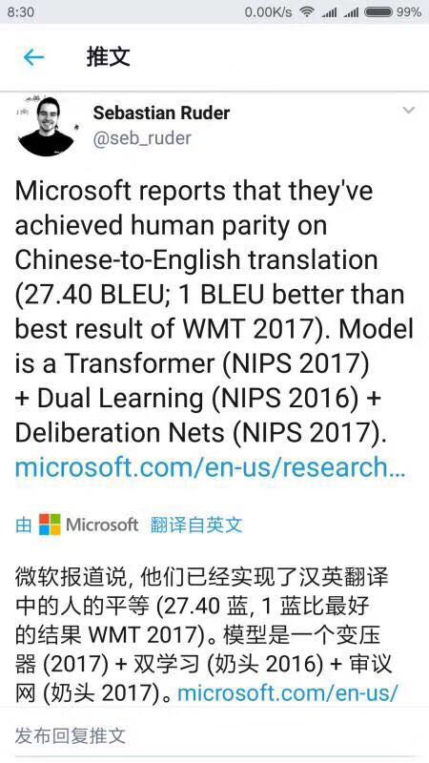
也不要被胜利冲昏了头脑！

Slide 35
AI的分支学科
按研究方法分
  符号智能
    搜索
    推理
    知识工程
  计算智能（软计算）
    自然计算
      神经计算，进化计算、免疫计算、粒群计算、混沌理论
    模糊数学和粗糙集
  机器学习和数据挖掘
    模式识别
  智能Agent

Slide 36
AI的分支学科
按应用领域
  自然语言处理
  计算机视觉（图像/视频识别与理解）
  计算机听觉（语音识别/合成）
  机器人
  智能XX（控制、管理、决策...）

Slide 37
人工智能的思考
有人把人工智能的发展方向分为
  运算智能（快速计算和记忆存储）
  感知智能（视觉、听觉、触觉等感知能力）
  认知智能（能理解会思考）
  这种说法合适吗？
李航说
  从情感、创造力和自由意志几个方面看，在现代计算机上实现强人工智能是非常困难的。

Slide 38
人工智能的思考
那么智能的本质是什么？
  苏格拉底：I know that I am intelligent, because I know that I know nothing.
  爱因斯坦：The true sign of intelligence is not knowledge but imagination.
  很多不同的智能类型：analytic, linguistic, emotional, creative, practical, learning, self-awareness…
  智能是涉身(embodiment)的吗？

Slide 39
AI领域著名会议（周志华）
tier-1:
IJCAI (1+): International Joint Conference on Artificial Intelligence
AAAI (1): National Conference on Artificial Intelligence
COLT (1): Annual Conference on Computational Learning Theory
CVPR (1): IEEE International Conference on Computer Vision and Pattern Recognition
ICCV (1): IEEE International Conference on Computer Vision
ICML (1): International Conference on Machine Learning
NIPS (1): Annual Conference on Neural Information Processing Systems
ACL (1-): Annual Meeting of the Association for Computational Linguistics
KR (1-): International Conference on Principles of Knowledge Representation and Reasoning
SIGIR (1-): Annual International ACM SIGIR Conference on Research and Development in Information Retrieval
SIGKDD (1-): ACM SIGKDD International Conference on Knowledge Discovery and Data Mining
UAI (1-): International Conference on Uncertainty in Artificial Intelligence

Slide 40
AI领域著名会议（周志华）
Tier-2:
AAMAS (2+): International Joint Conference on Autonomous Agents and Multiagent Systems
ECCV (2+): European Conference on Computer Vision
ECML (2+): European Conference on Machine Learning
ICDM (2+): IEEE International Conference on Data Mining
SDM (2+): SIAM International Conference on Data Mining
ICAPS (2): International Conference on Automated Planning and Scheduling
ICCBR (2): International Conference on Case-Based Reasoning
COLLING (2): International Conference on Computational Linguistics
ECAI (2): European Conference on Artificial Intelligence
ALT (2-): International Conference on Algorithmic Learning Theory
EMNLP (2-): Conference on Empirical Methods in Natural Language Processing
ILP (2-): International Conference on Inductive Logic Programming
PKDD (2-): European Conference on Principles and Practice of Knowledge Discovery in Databases

Slide 41
AI领域著名会议（周志华）
Tier-3:
ACCV (3+): Asian Conference on Computer Vision
DS (3+): International Conference on Discovery Science
ECIR (3+): European Conference on IR Research
ICTAI (3+): IEEE International Conference on Tools with Artificial Intelligence
PAKDD (3+): Pacific-Asia Conference on Knowledge Discovery and Data Mining
ICANN (3+): International Conference on Artificial Neural Networks
AJCAI (3): Australian Joint Conference on Artificial Intelligence
CAI (3): Canadian Conference on Artificial Intelligence
CEC (3): IEEE Congress on Evolutionary Computation
FUZZ-IEEE (3): IEEE International Conference on Fuzzy Systems
GECCO (3): Genetic and Evolutionary Computation Conference
ICASSP (3): International Conference on Acoustics, Speech, and Signal Processing
ICIP (3): International Conference on Image Processing
ICPR (3): International Conference on Pattern Recognition
IEA/AIE (3): International Conference on Industrial and Engineering Applications of Artificial Intelligence and Expert Systems
IJCNN (3): International Joint Conference on Neural Networks
IJNLP (3): International Joint Conference on Natural Language Processing
PRICAI (3): Pacific-Rim International Conference on Artificial Intelligence

Slide 42
AI领域著名期刊
  Journal of Machine Learning Research
  Artificial Intelligence
  Artificial Intelligence Review
  AI Magazine
  Machine Learning
  Computational Intelligence
  Journal of AI Research
  Pattern Recognition
  Artificial Intelligence in Medicine
  IEEE Trans. on Pattern Analysis & Machine Intelligence
  IEEE Trans. on Knowledge & Data Engineering
  IEEE Trans. on Neural Networks
  Journal of Data Mining & Knowledge Discovery

Slide 43
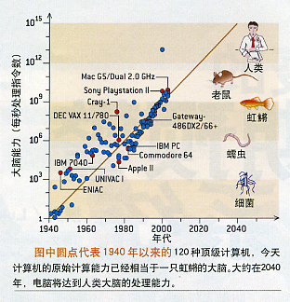
计算机的发展
图来自史忠植教授的讲义

Slide 44
AI能造出超人？
最近AI的发展得益于计算能力的提高和大数据的易得
Computers will be like humans by 2029: Google’s Ray Kurzweil http://singularity.com/
Experts believe that AI will outperform humans in many activities in the near future, such as translating languages (by 2024), writing a high-school essay (by 2026), driving a truck (by 2027), working in retail (by 2031), writing a bestselling book (by 2049), and working as a surgeon (by 2053). (https://arxiv.org/abs/1705.08807)

Slide 45
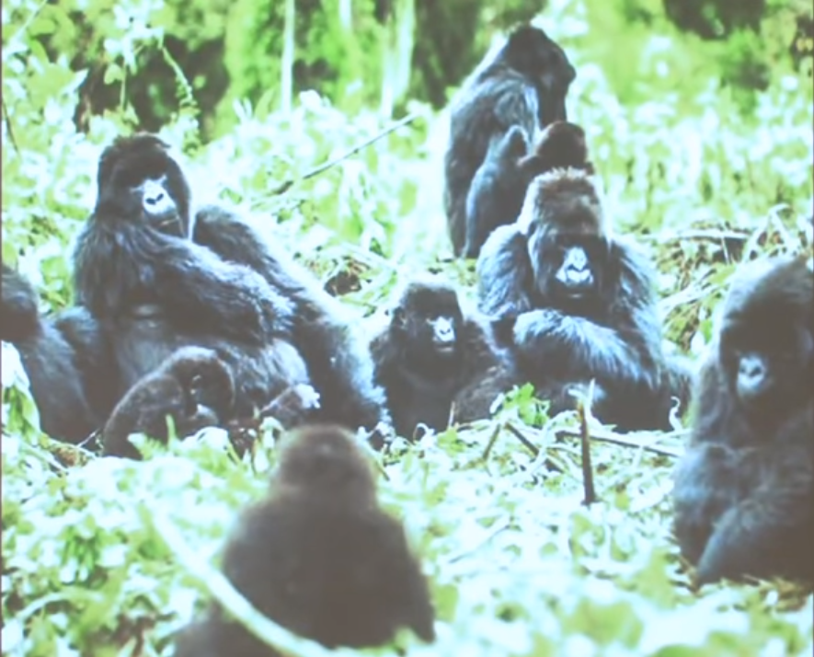

Slide 46
AI Era is here
“Now this is not the end. It is not even the beginning of the end. But it is, perhaps, the end of the beginning.”
--Winston Churchill

Slide 47
Misuse of AI
Lethal autonomous weapons
Cyber attack by AI systems
Adaptive blackmailing
Fake news/tweets by AI bots
Deepfake
360/各类管家/各种浏览器的风险！
支付宝/微信支付的危险！
隐私保护/数据完整性越来越重要
区块链？

Slide 48
人工智能与中国
2015年07月，国务院发布“互联网+”行动的指导意见，部署11大行动，其中就包括“互联网+”人工智能
2017年7月，国务院发布《新一代人工智能发展规划》
2017年10月，习近平总书记在十九大报告中强调：“推动人工智能与实体经济深度融合。”
2018年4月，教育部发布《高等学校人工智能创新行动计划》：到2020年建立50家人工智能学院、研究院或交叉研究中心，加大人工智能领域人才培养力度

Slide 49
人工智能与中国
中国人工智能人才缺口超500万 供求比例仅为1：10（人民日报：http://finance.people.com.cn/n1/2017/0714/c1004-29404223.html）中国人工智能人才总量为世界第7，仅占美国6%，还不如印度
2018.8.7，26高校（包括清华、南大、复旦、上交大、西交大、浙大、哈工大、东南大、武汉大、厦大等）首次在北航集会，提出申办人工智能本科专业。中央教育电视台、北京电视台、中国日报网、人民日报海外版等10多家媒体对此进行报道。

Slide 50
Course overview
授课计划：
  人工智能介绍
  智能体
  搜索
  不确定性和概率推理
  机器学习
  自然语言处理
  多模态学习

Slide 51
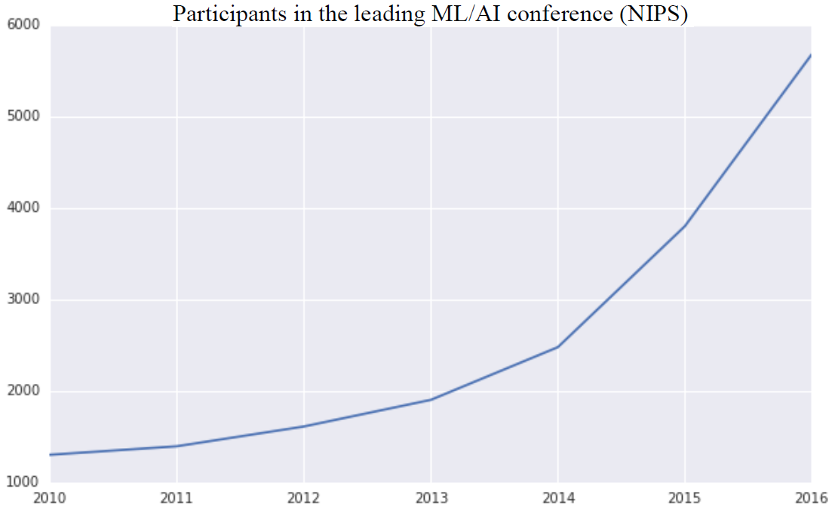
AI BOOM: THE ACADEMIC PERSPECTIVE

Slide 52
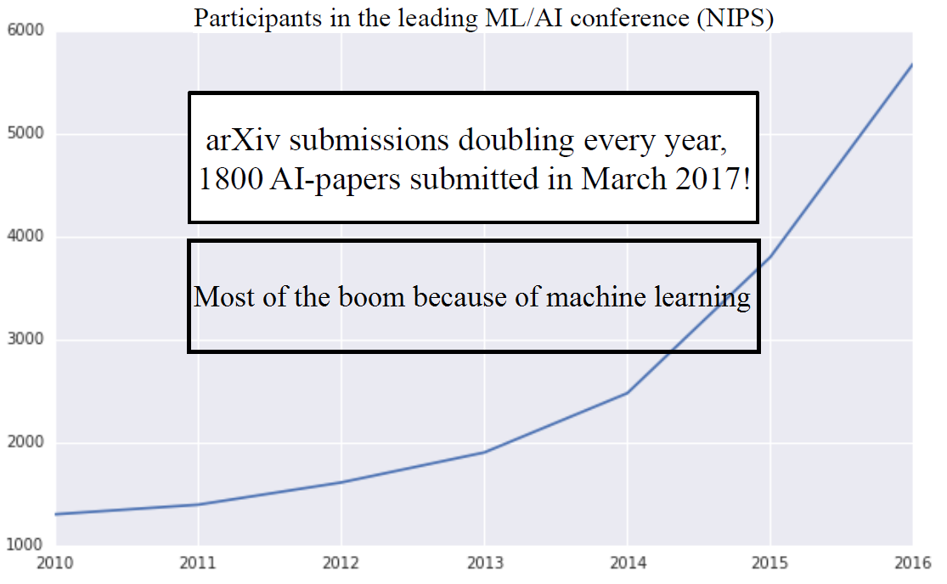
AI BOOM: THE ACADEMIC PERSPECTIVE

Slide 53
补充内容1
论文选读
  增加论文选读，加深对重要论文和目前国际研究现状的了解
  论文列表会出现在ppt中，大家可选择阅读，有时会就论文在课上提问，从而检查阅读情况

Slide 54
补充内容2
根据我的研究领域，适当补充一、两节课加以介绍（本次拟请外校老师讲）
前面讲过的内容有：
  Web挖掘（数据挖掘分支）：目前WEB是许多AI应用的数据源（博客、微博等），如何从中挖掘数据，表示数据，值得研究
  简繁汉字转换：如何采用语言处理技术减少两岸交流障碍，助力和平发展
  基于云计算的协同式多语言翻译平台：利用自然语言处理技术改造传统的翻译产业
  少数民族语言处理：通过语言技术减少数字鸿沟
  神经机器翻译

Slide 55
课程设计
6个人左右一组，做1个课程设计。课程设计不限于课上讲述的内容，与书上的有关章节相关或与你们的研究方向相关的都可以。课程设计完成后，选一名代表做一个演讲。
课程设计必须给出实验报告或论文。实验报告要描述清楚细节；如果是论文，那么必须要基本达到能发表的要求。

Slide 56
成绩计算
成绩将参照平时作业（20）、期末考试（65）、课程设计（15分，其中演讲印象得1或2分）综合给出。
作业通过ftp上传到服务器，命名
姓名_学号_第N次作业.doc
其中N=1，2，3…

Slide 57
如何学好本课程
看书、做作业、读论文；打好基础，了解热点；根据自己的兴趣，选择合适的领域进行深入学习
跟随巨人的脚步
  Google “ten most important people in AI” …
站上巨人的肩膀，更上一层楼！
  让厦大以你为荣！

Slide 58
作业
阅读图灵关于AI的1950年的论文。请你结合AI几十年来的发展，对他的主要观点进行评述。特别是通过图灵测试的可能性。
阅读文章
  Stuart Russell, on the Future of Artificial Intelligence 2003, https://ubiquity.acm.org/article.cfm?id=964695
  Executive Office of the President，National Science and Technology Council， PREPARING FOR THE FUTURE OF ARTIFICIAL INTELLIGENCE, 2016
  结合这两年人工智能的热门，谈谈你对人工智能看法

Slide 59
作业
查询AI文献，看看如下的任务现在计算机能否解决，并找出其难点且对其解决的年代进行预测：
  乒乓球比赛
  在市中心开车
  去超市买东西
  在网上买东西
  参加桥牌比赛
  发现并证明数学定理
  写一个有趣的故事
  从英语到西班牙语的口语实时翻译
  完成复杂的外科手术

Slide 60
作业
阅读相关论文，看看在AlphaGo中，采取了那些新的人工智能技术？特别与1997年深蓝战胜Kasparov的AI技术做比较。

Slide 61
论文选读
A. Turing, 1950, Computing Machinery and Intelligence
N. Nilson，1991，Logic and artificial intelligence. In Artificial Intelligence 47 (1991) 31-56
Thomason, Richmond, "Logic and Artificial Intelligence", The Stanford Encyclopedia of Philosophy (Spring 2009 Edition) http://plato.stanford.edu/entries/logic-ai/

Slide 62
论文选读
G. E. Hinton, 2007, "Learning multiple layers of representation," Trends in Cognitive Sciences, 11, pp. 428–434.
David Silver et al, 2016, Mastering the game of Go with deep neural networks and tree search，Nature 529, 484–489 (28 January 2016)

